Slide 1
Stock Market Data Analysis of Berger Paint
Team: Group -5
Mentors: Karthik Muskula and Dhanyapriya
Date: 23-02-2023

Slide 2
Project Flow:
Business problem and Objective.
Data Extraction and Data set details.
Exploratory Data Analysis (EDA).
Analysis of Data before.
Data Visualization.
Model Building & Evaluation.
Deployment.

Slide 3
Business Problem:
In stock market it is difficult for the traders to make a decision for which company he/she should invest based on the future value of the stock.
Objective:
The main aim of this project is to predict future stock prices of different companies / whether the trader should invest in a stock (Yes/No).

Slide 4
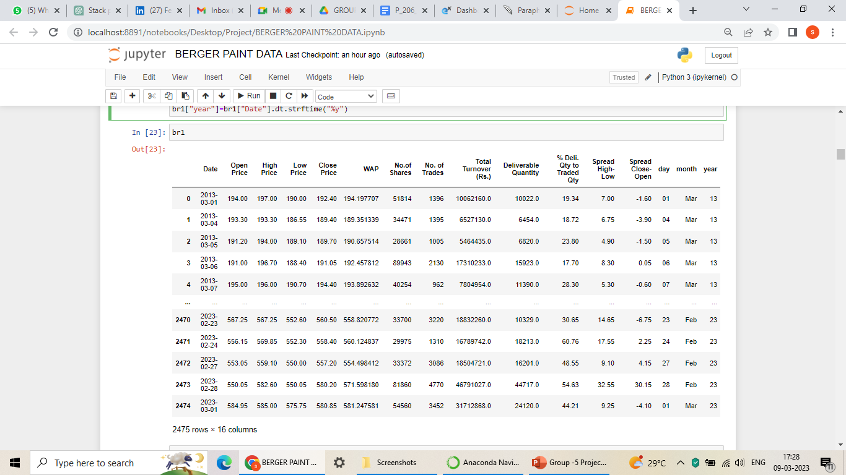
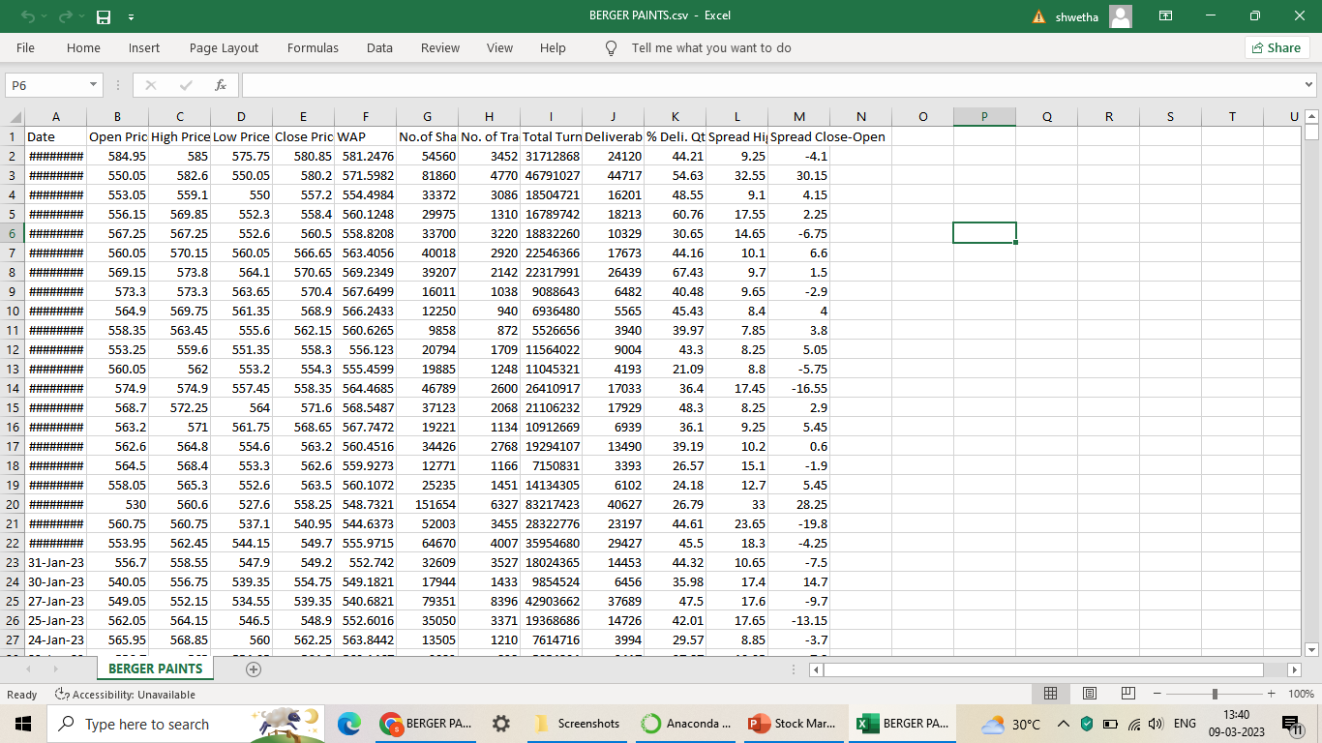
Extraction of Data and Data set details:
The information concerns BERGER’s PAINT shares.
Information about BERGER’s PAINT shares is obtained from Bombay Stock Exchange (BSE).
We are dealing with stock data from the last Ten years(March 2013 to March 2023.
We have also added the columns days, years and months for better visualization.

Slide 5
EXPLORATORY DATA ANALYSIS (EDA)

Slide 6
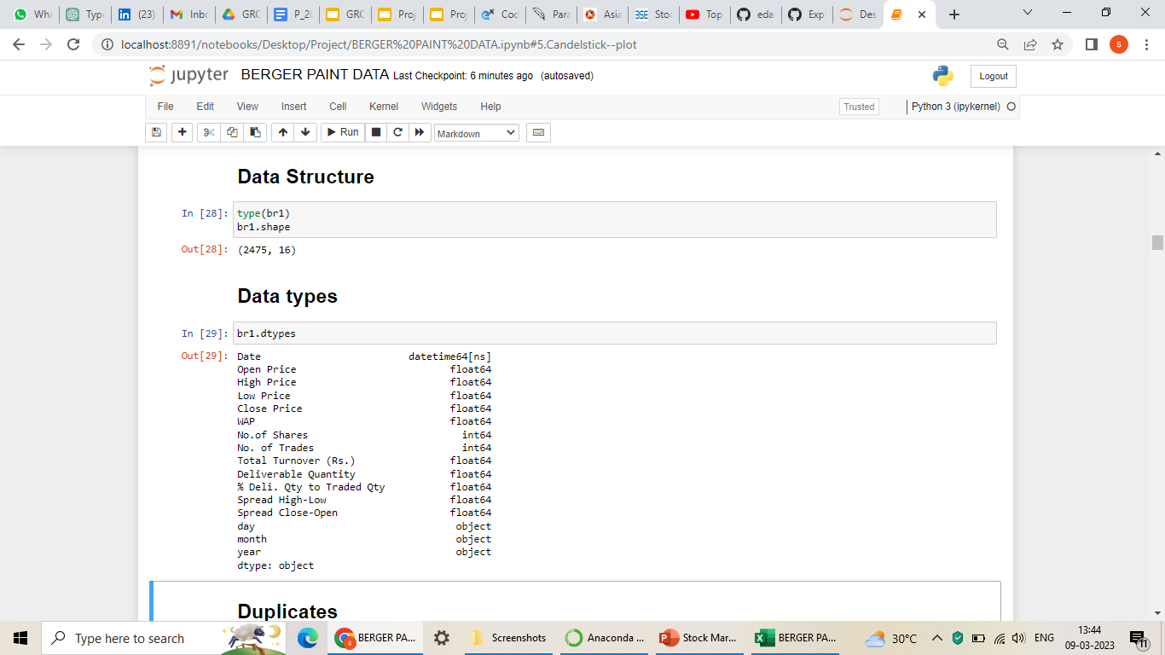
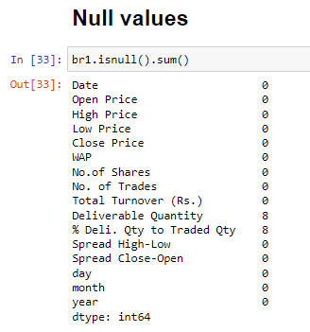
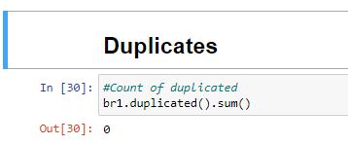
Analysis of Data before:
Imported the required libraries.
Checked for the data type(float64, int64 & Object).
The Data shape (Column =2475, Rows=13)
Duplicates = 0

Slide 7
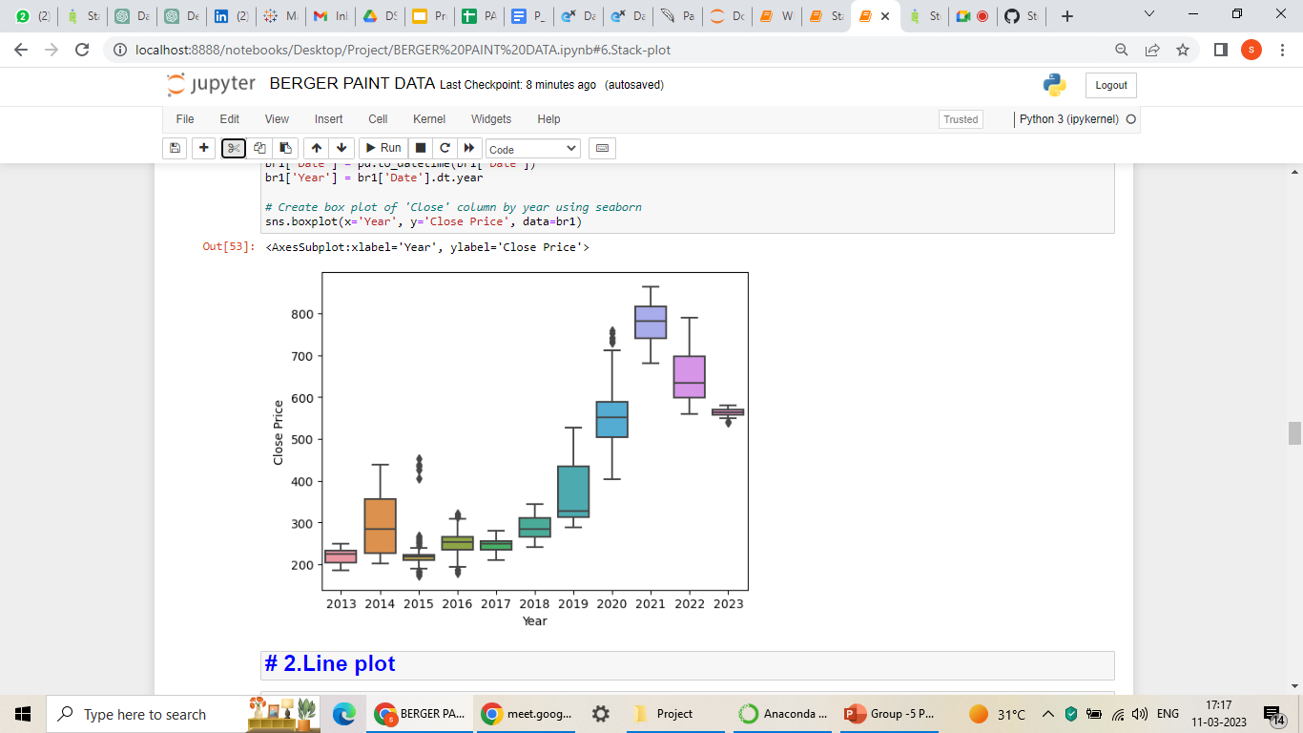
Box Plot:
Here, we used a box plot to identify outliers.
The box is symmetrically distributed around the median, the data is roughly symmetric.
We can see the outliers in 2015, 2016, 2020 and 2023.

Slide 8
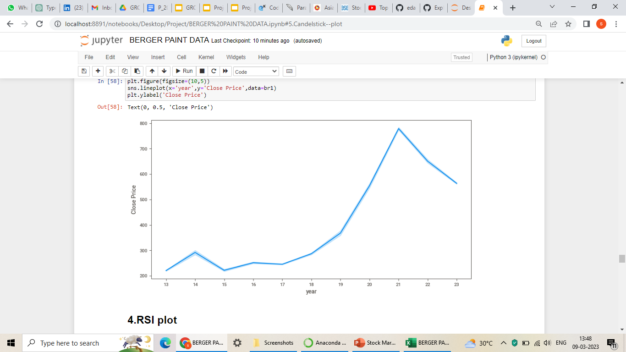
Line Plot:
The lines connecting the data points show how the dependent variable changes as the independent variable increases.
Here the dependent variable changes as the independent variable increases.
We can see that the price has dropped from 2021 to till date.

Slide 9
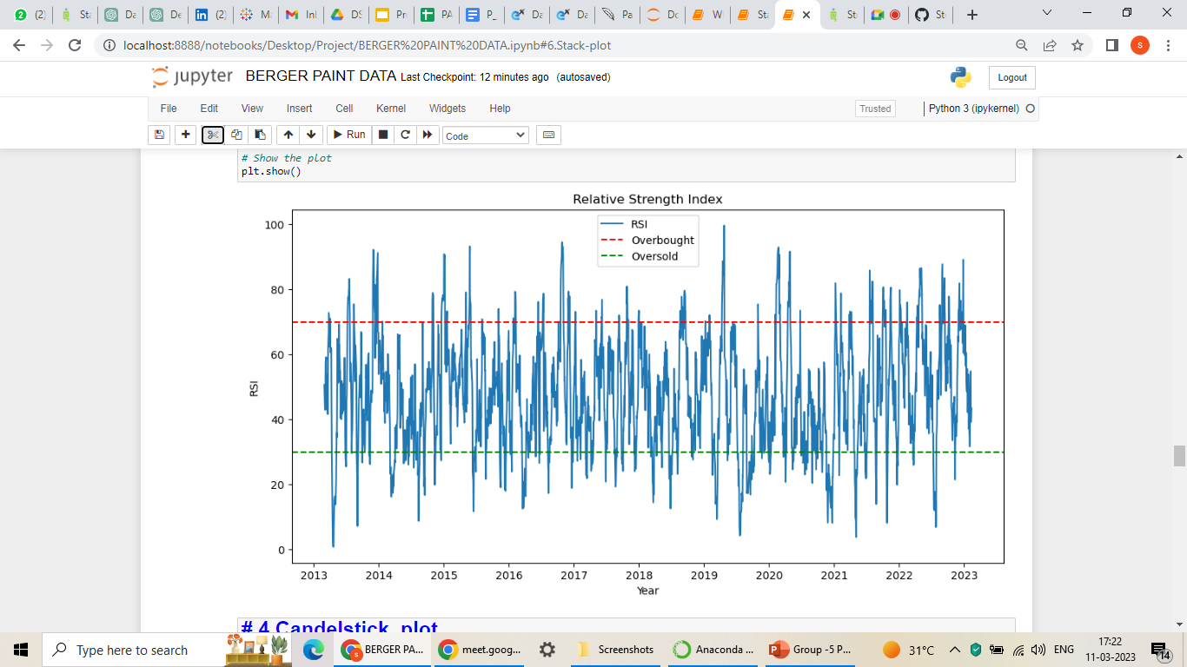
RSI (Relative Strength Index) Plot:
Here we can measure the strength and momentum of a security's price.
line graph that ranges from 0 to 100, with levels above 70 indicating overbought conditions and levels below 30 indicating oversold conditions.
The red colour line indicates the level 70 and 30.

Slide 10
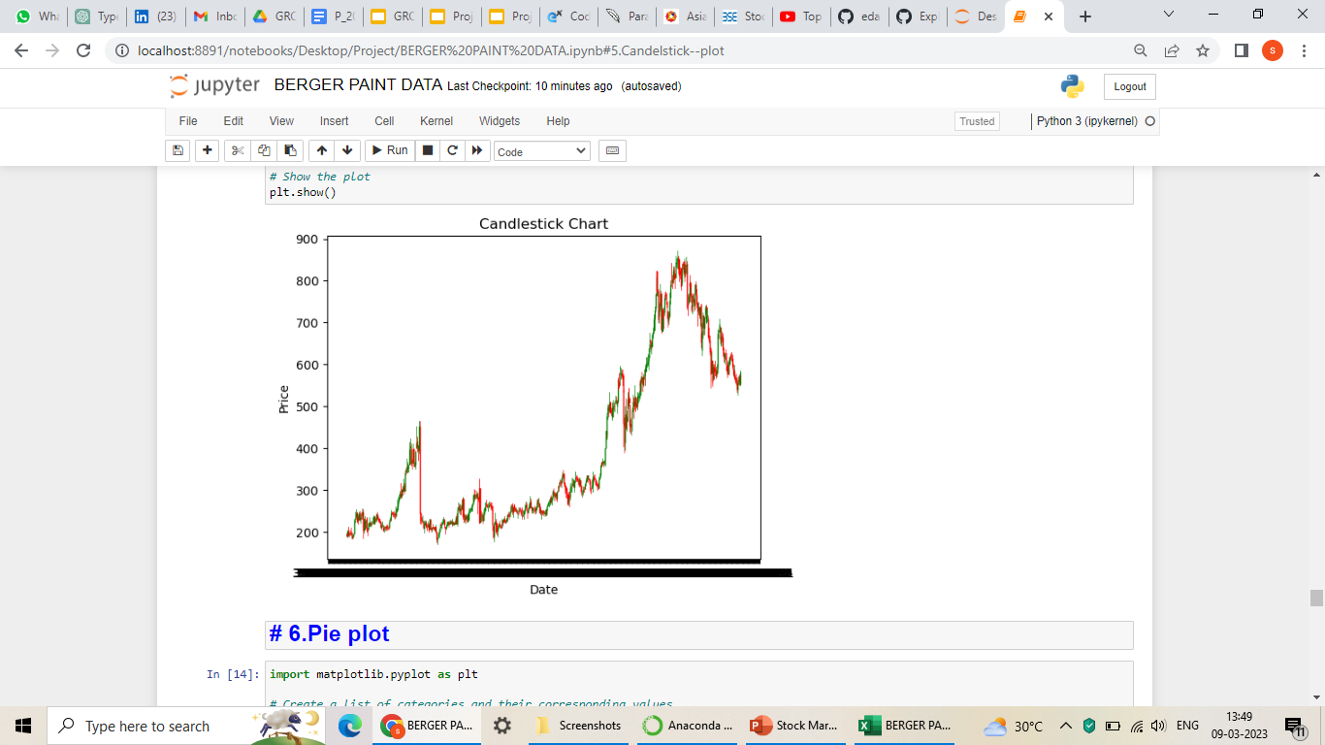
Candelstick Plot:
The plot displays the open, high, low, and close prices for a given time period.
Here we can see the difference between the opening and closing prices, with a green body indicating a price increase and a red body indicating a price decrease. The shadows represent the high and low prices for the period.

Slide 11
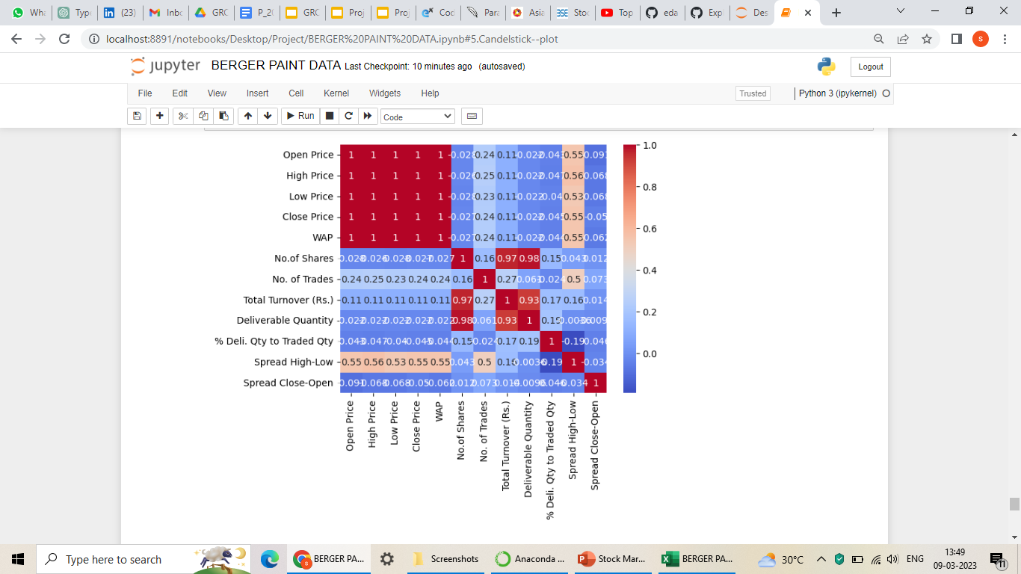
Heat Map:
Here the Close Price, Open Price, High Price, Low Price, WAP are highly correlated with each other.
The remaining columns are minimal correlated.

Slide 12
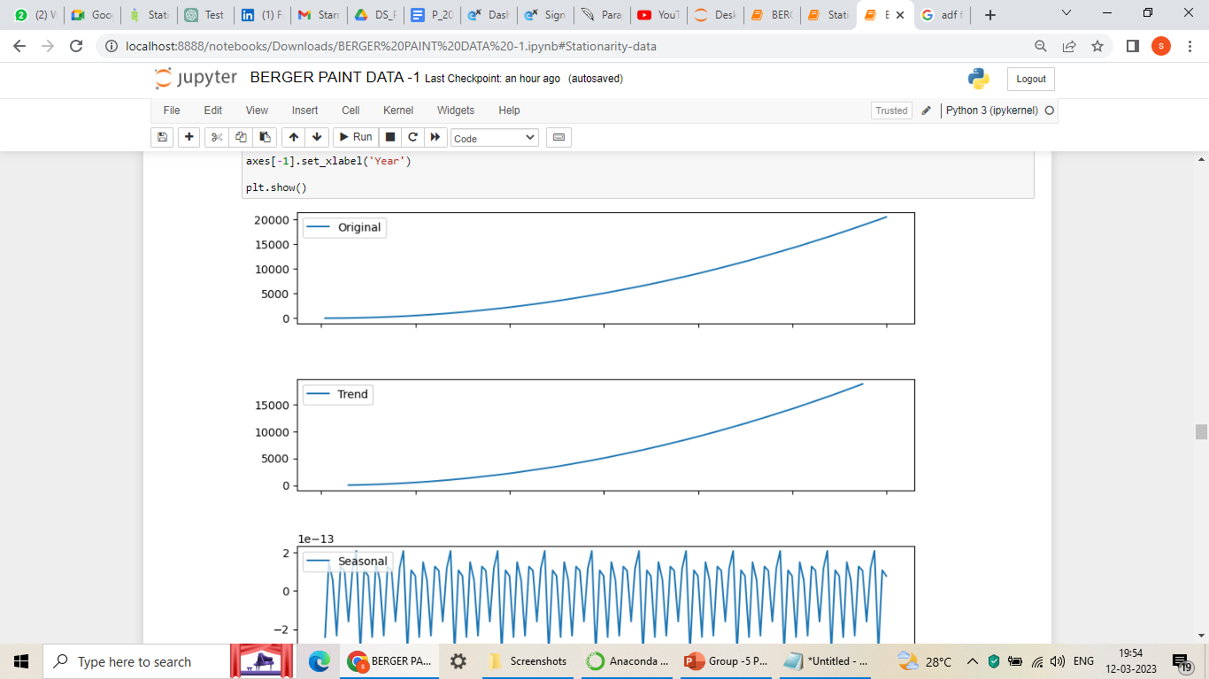
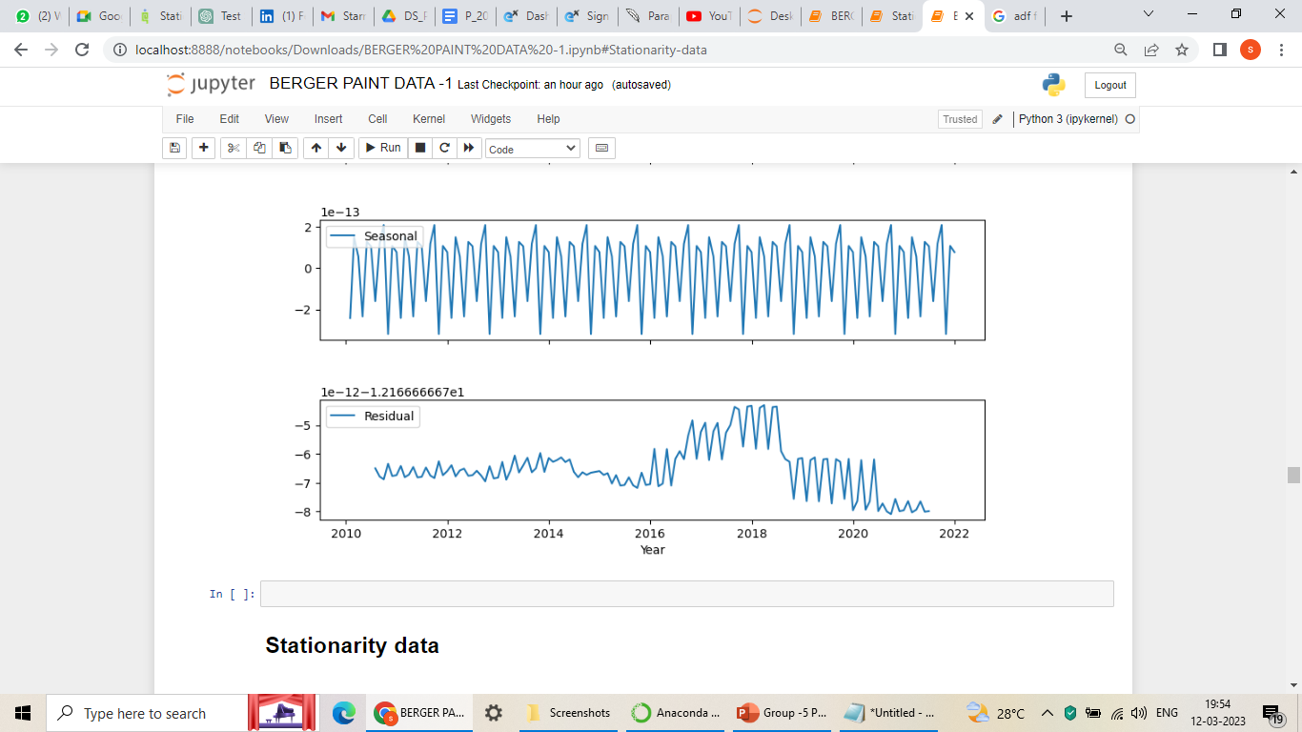
Decomposition Map:
Trend, seasonality, and residual components of the underlying structure of a time series data.

Slide 13
STATIONARITY DATA:

Slide 14
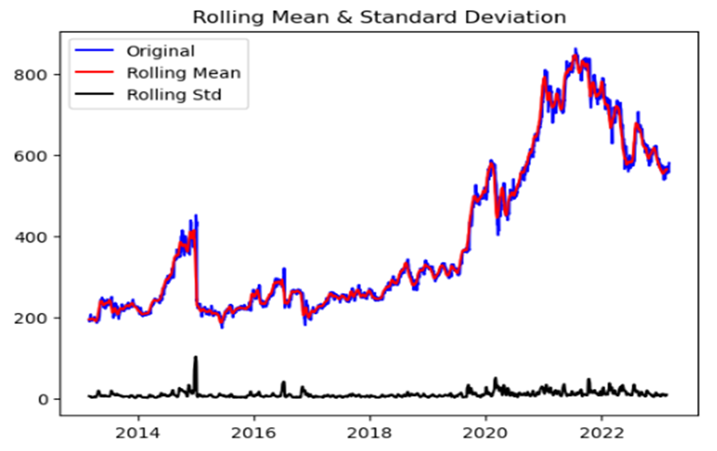
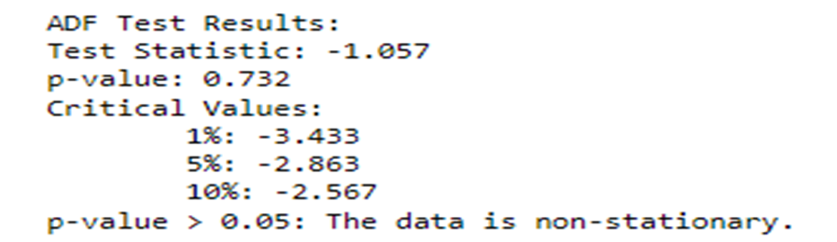
Augmented Dickey–Fuller test (ADF):
Below are types of testing we performed to find out whether the data is stationary:
In this slide we can see that the data has Non stationary while the p value is higher.
Thus, we conclude this as non stationary.

Slide 15
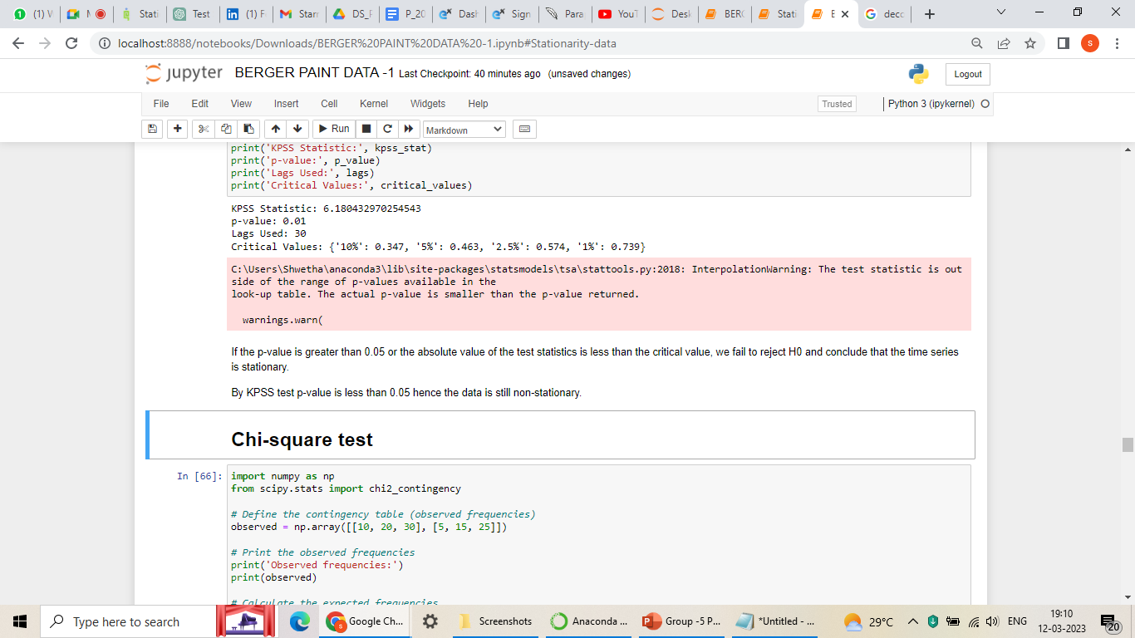
Kwiatkowski-Phillips-Schmidt-Shin Test:

Slide 16
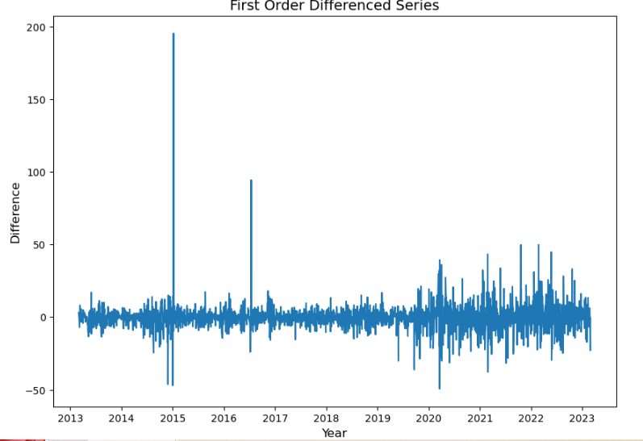
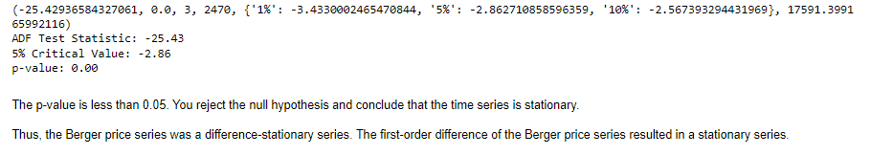
First order differenced series:
Here the p-value is less than 0.05 we reject the null hypothesis and conclude that the time series is stationary.
Thus, the Berger price series was a difference-stationary series. The first-order difference of the Berger price series resulted in a stationary series.
Applied the ADF test on the differenced series and check if the series is stationary or not:

Slide 17
MODEL BUILDING
To build the model we have tried different methods like :
ARIMA (Autoregressive Integrated Moving Average (ARIMA))
SARIMA (Seasonal Autoregressive Integrated Moving)
LSTM (Long Short-Term Memory)

Slide 18
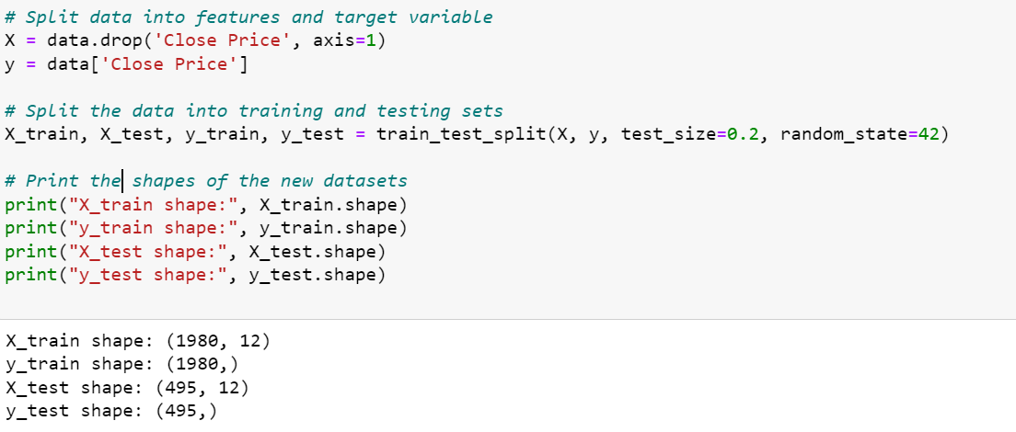
Train-Test Split
Time series train-test split must consider the temporal order of data, resulting in a training set of shape and a testing set of shape.
We have consider 80-20 rule for data splitting - 80% data for training the model and 20% of data for testing the model.
To create a model for the BERGER PAINTS Stock, training and testing data have the following shapes: (1980,) (495,) correspondingly.

Slide 19
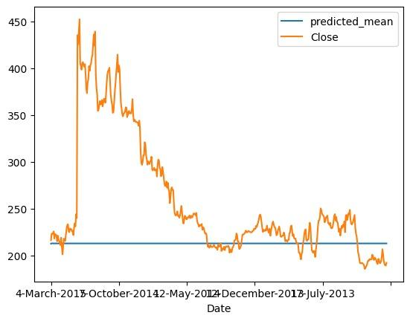
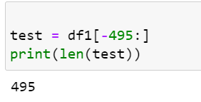
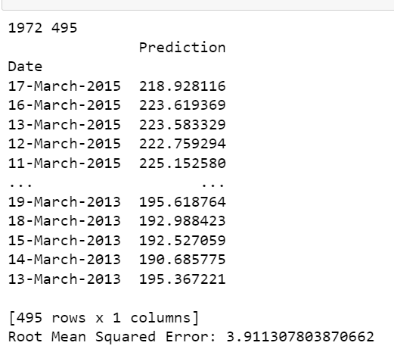
ARIMA(AutoRegressive Integrated Moving Average)
It is a powerful tool for analysing and predicting trends in data that varies over time.
Blue line indicates Predicted mean and Orange line indicates Close price.

Slide 20
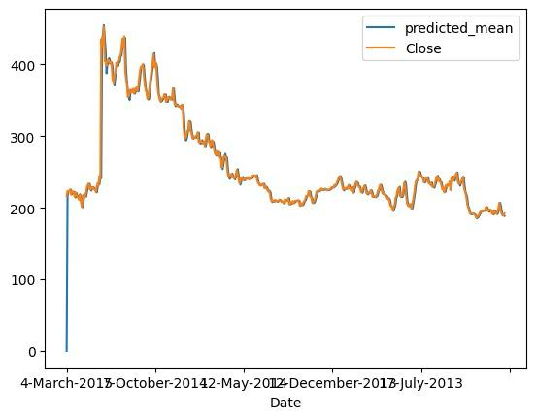
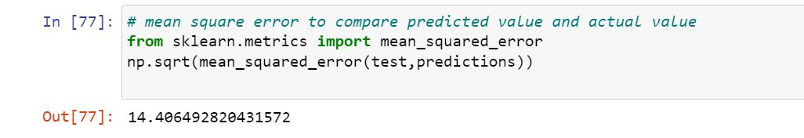
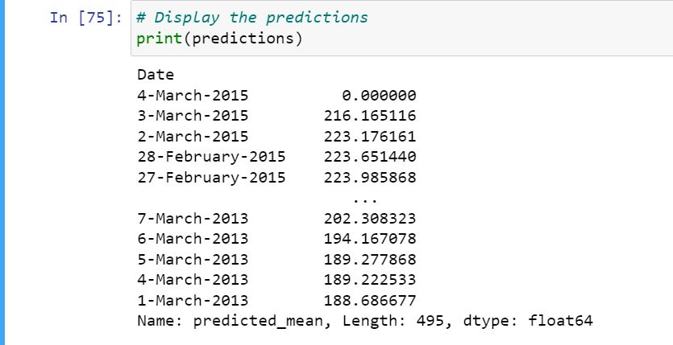
SARIMA(Seasonal Autoregressive Integrated Moving Average)
It is an extension of the ARIMA model that takes into account seasonal patterns in time series data.
Blue line indicates Predicted mean and Orange line indicates Close price.

Slide 21
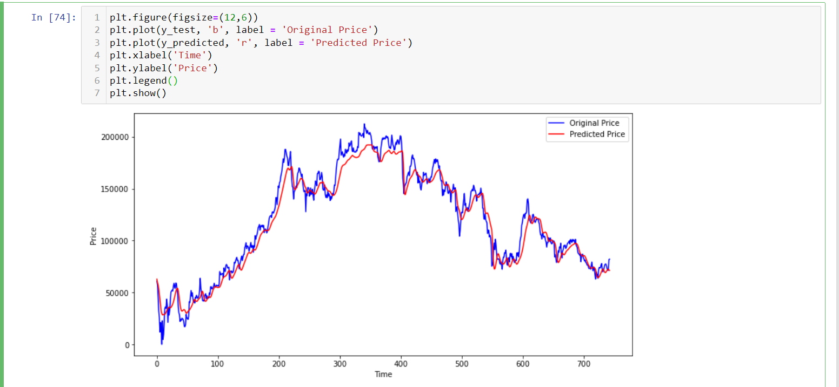
Long Short-Term Memory:
Blue line indicates Original Price and Red line indicates Predicted Price.

Slide 22
DEPLOYING MODEL
Streamlit (pip install streamlit)
Created a H5 file from jupyter note book and copies the file to the new folder.
Created new python file to proceed with streamlit.
In VS code imported required library and installed the packages.
Loaded the pre-trained LSTM model.

Slide 23
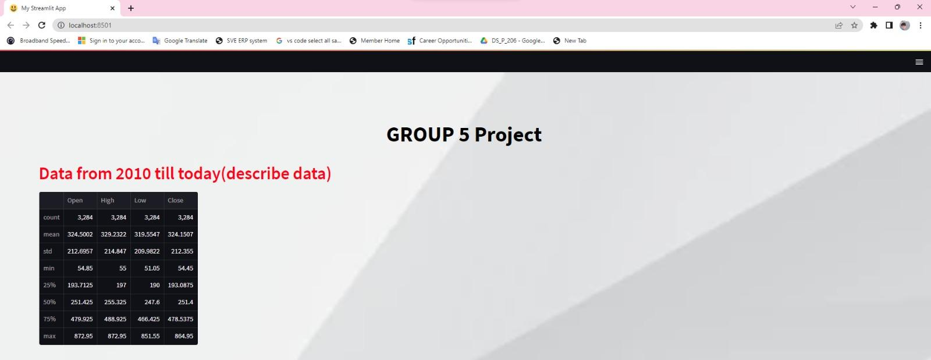
IMPORTING AND DESCRIBING DATA
In command prompt, run the streamlit (describe data)

Slide 24
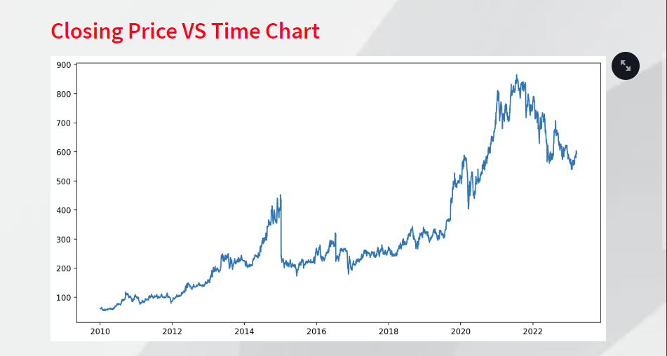
Visualization:
Visualizing The Closing Price VS Time Chart:

Slide 25
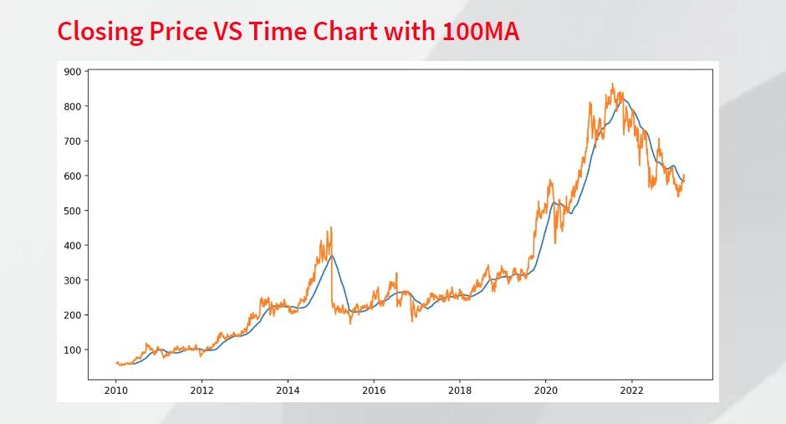
Visualizing The Closing Price VS Time Chart With 100days MA:
Blue line indicates the MA.
It takes the average of previous 100days Closing price.

Slide 26
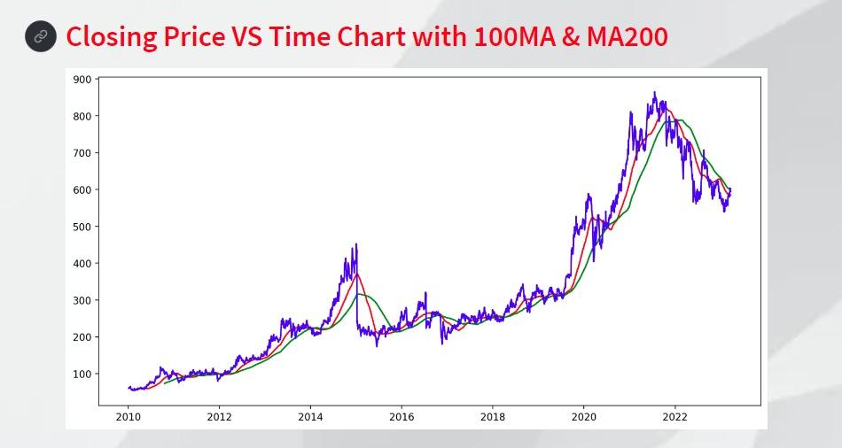
Visualizing The Closing Price VS Time Chart With 100days MA And 200days MA:
Red line indicates the 100days MA and Green line indicates the 200days MA.
Has the red line falling below the green line that says it is DOWNTrend.

Slide 27
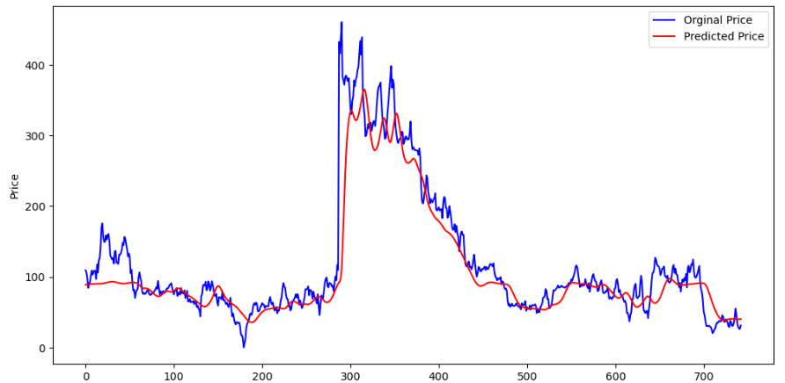
Visualizing the Actual vs Predicted values:
Blue line indicates Original Price and Green indicated Predicted Price.

Slide 28
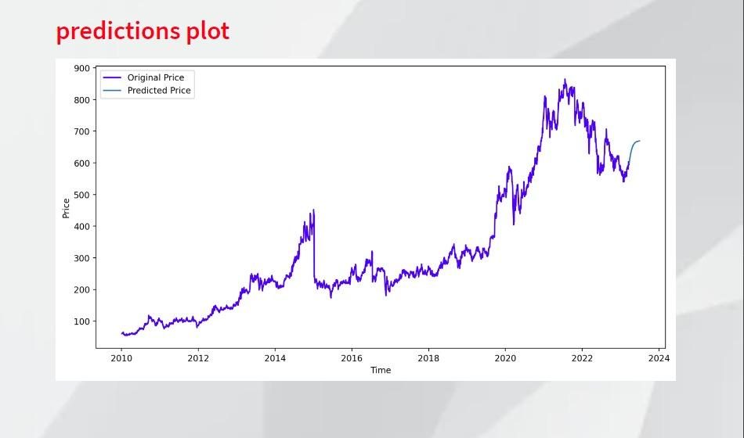
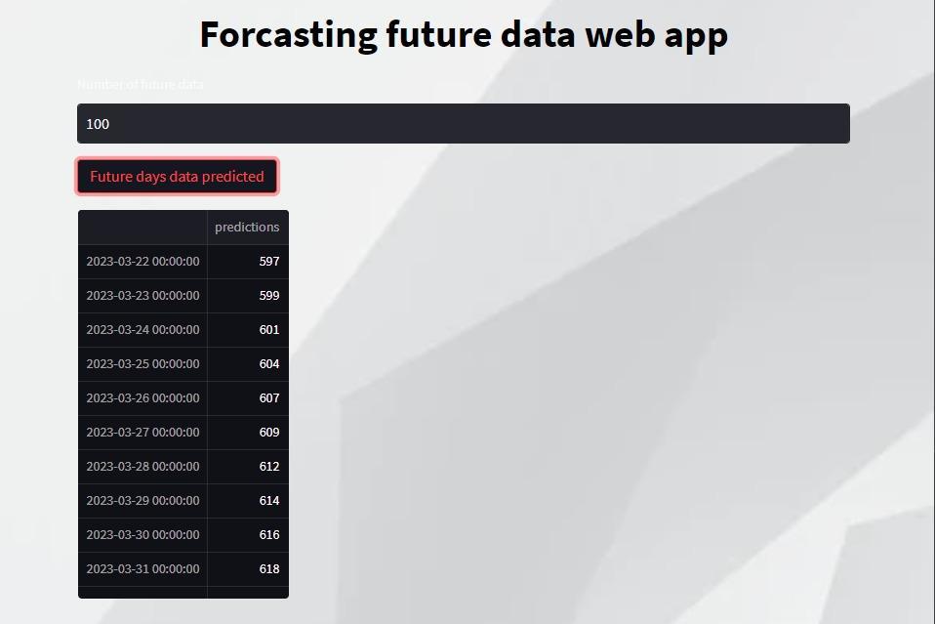
Forecasting The Close Price For Next 100days:
Blue line indicates Original Price and Green indicated Predicted Price.

Slide 29
Conclusion:
Here the closing price is in a downtrend, it suggests that the overall trend of the stock is downwards.
It means that over the period of time being analyzed, the stock has been consistently decreasing in value, which indicates that investors are selling off their shares is negative towards the stock.
However, a single downtrend in the closing price does not necessarily indicate a long-term trend. It could be a temporary dip in the market.
It's important to consider other factors that could be affecting the stock price, such as economic news, company-specific news, volume, price levels, technical indicators, to confirm the trend or changes in market sentiment.
These factors can have a significant impact on the price of the stock, and should be taken into account when analyzing trends in the closing price.

Slide 30
Challenges Faced:
1.ARIMA, SARIMA , LSTM
2.Model was taking a lot time to run.(100 epochs)
3.Deploy model on streamlit
4. Also tried for Django

Slide 31
THANK YOU

